Slide 1

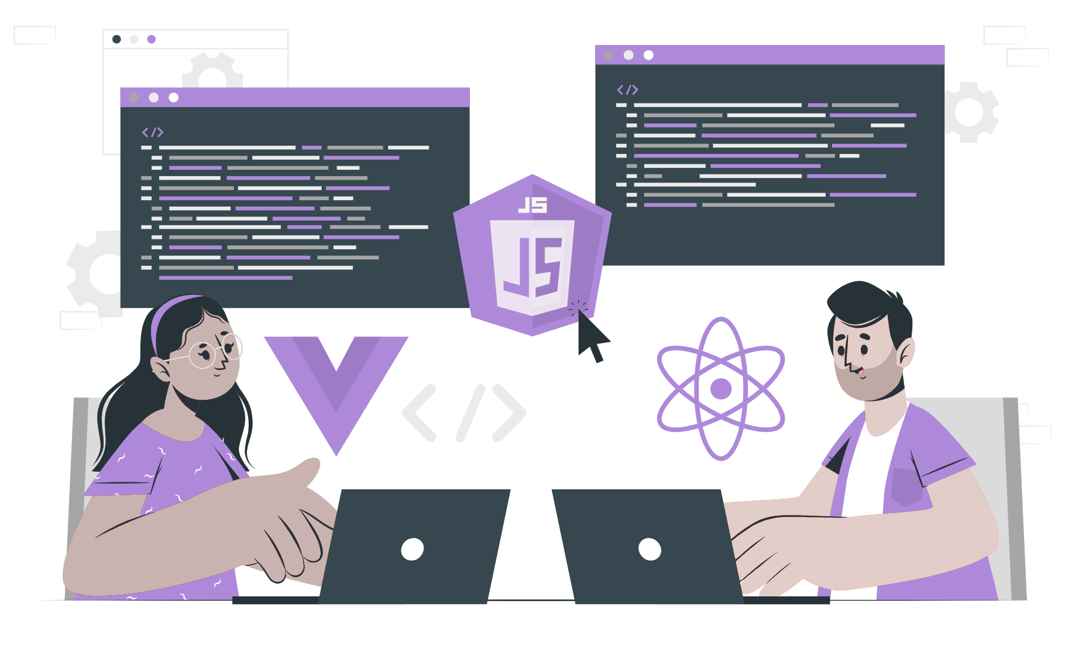
JSX

Slide 2
Topics Covered
What is JSX?
Difference between JSX and HTML.
Why JSX?

Slide 3
What is JSX
JSX stands for JavaScript XML.
It allows us to write HTML like syntax in your javascript code.
We use transpiler like babel to convert jsx to js.

Slide 4
Difference Between JSX and HTML
Multiple elements can be returned in HTML.
Nested JSX must return a single element that wraps all other levels of nested elements.
All HTML attributes and event references in JSX become camelCase, this way, onclick event becomes onClick and onchange — onChange.
Browsers can’t read JSX.

Slide 5
Why Jsx?
JSX code makes it simple to construct dynamic components.
it is simpler to write and read.
keeps your code clean and manageable.
More faster than standard JavaScript

Slide 6
THANK YOU

